Slide 1
Standards & Regulations
Team F RoboSAR
Charvi Gupta, Indraneel Patil, Jae Song, Naren Sriram, Rachel Zheng

Slide 2
ASTM E2853-12
Standard Test Method for Evaluating Emergency Response Robot Capabilities

Slide 3
What is it about?
“The testing results of the candidate robot shall describe, in a statistically significant way, how reliably the robot is able to perform the specified types of tasks and thus provide emergency responders sufficiently high levels of confidence to determine the applicability of the robot.”
A disaster has occurred! We want robots to help, but…
How do you know if your robot has the right capabilities? What if it just gets in the way?
If choosing between multiple robot systems to deploy, how do you make the decision? What metrics do you use?
Standard defines method of testing to determine how well a robot would do in emergency situations.
Teleoperated ground robots only.

Slide 4
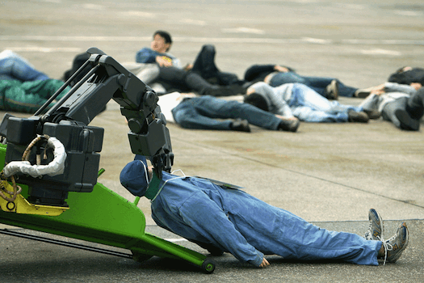
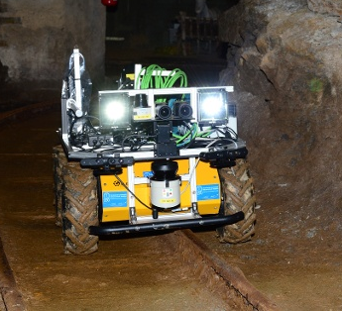
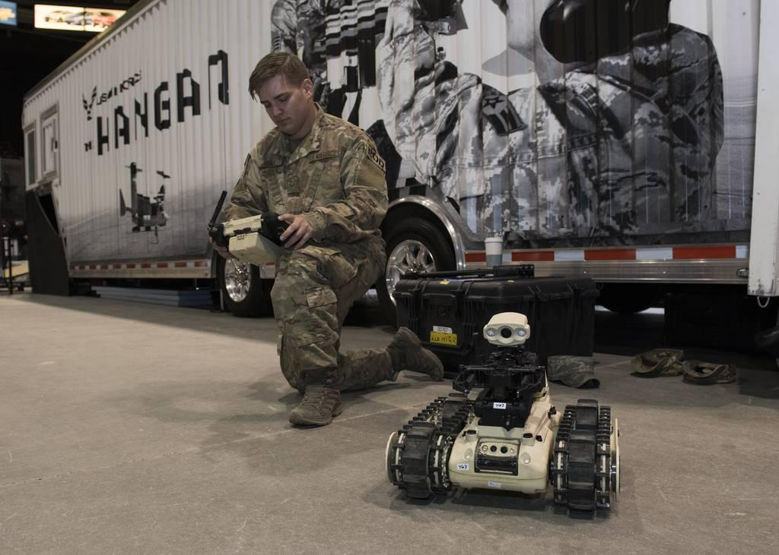
To which products/markets does it apply?
Robots operating in emergency or disaster situations, to be used by emergency responders
Bomb difusal robots; military
Mining robots; mining
Search and rescue; emergency services
Notes:
WTF is that robot doing to that guy’s head??????????????????????????

Slide 5
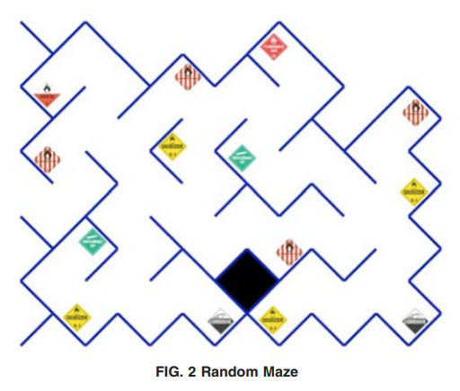
Setup
Random maze with uneven ground
Hazardous material signs placed in maze
Operator must report sightings (coverage) and descriptions (clearance) of signs
Test sponsor can specify relative weights of metrics
Test is complete when robot returns to starting position

Slide 6
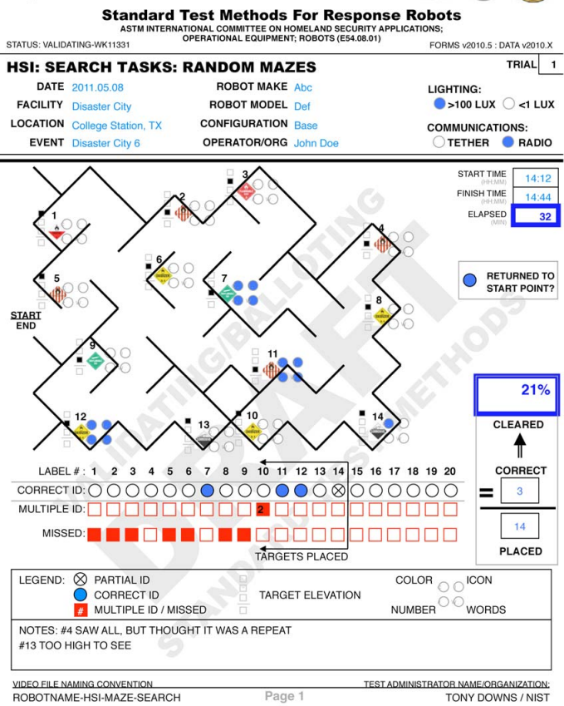
Evaluation
Human intervention / assistance is a fault and will be penalized
Sign is covered if it is reported
Sign is cleared if at least 3 of 4 descriptors are correct: color, icon, number, words
Performance is weighted mix of:
# of covered targets
# of cleared targets
Avg #targets cleared or covered / time

Slide 7
How does it apply to the team's project?
Testing standards gave inspiration for our FVD and FVD Encore
Robot must navigate complex, visually similar environments
Robots must detect and understand markers
System must report location of markers
Robots shall home once test has completed
Use detections / time as a metric
Human intervention will be penalized

Slide 8
ISO/TS 15066
Safety Requirements for Collaborative Industrial Robot Systems

Slide 9
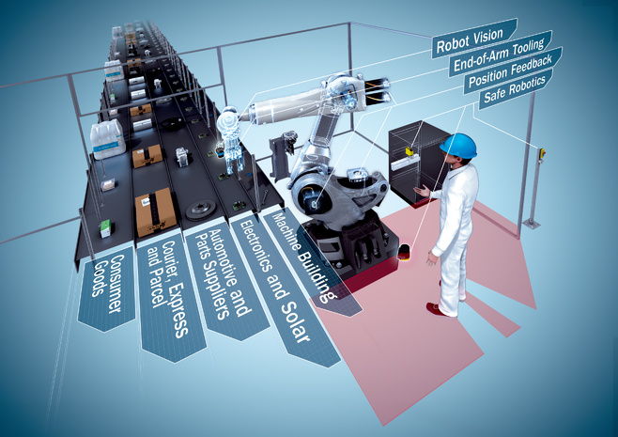
What is it about?
Physical contact between the operator and the robot system can occur within a collaborative workspace.
Need standard safety regulations!
Require protective measures to ensure the operator’s safety
Require risk assessment to identify hazards and estimate risks and proper risk reduction measures

Slide 10
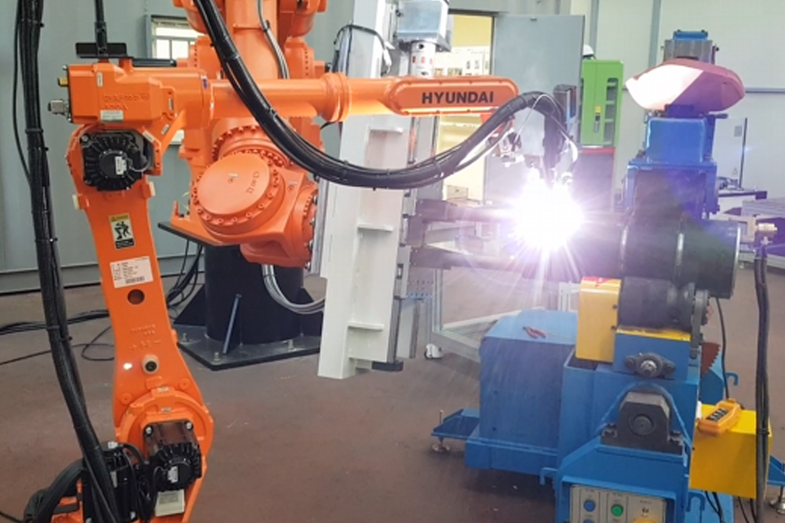
To which products/markets does it apply?
Industrial Robots - an autonomous system of sensors, controllers, and actuators on an articulated frame that executes specific functions and operations in a manufacturing or processing line.
Typical Applications -
Welding
Pick and place
Assembly and disassembly
Packaging and labelling

Slide 11
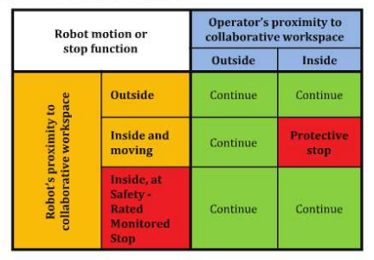
What are its main prescriptions?
Safety-rated monitored stop
Used to stop robot motion before an operator enters the area to interact with the system.
Motion can resume without any additional intervention only after the operator has exited the workspace.
Hand guiding
Mode where operator uses a hand-operated device to transmit motion commands.
Non-collaborative operation resumes when operator leaves collaborative workspace.

Slide 12
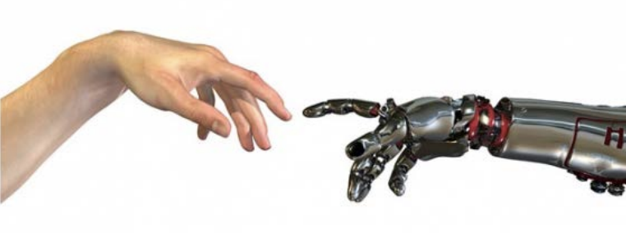
What are its main prescriptions?
Speed and Separation Monitoring
Maintain protective separation distance between operator and robot.
Protective distance is higher at high speed of operations.
Power and Force Limiting
Speed, torque, motion of the robot is maintained such that incidental contact does not cause harm.

Slide 13
How does it apply to the team's project?
When working closely with robots, we need to be careful of safety dangers.
Inspiration for collaborative features: E-stop, tele-op, homing.
Making sure the system is communicating its state with its users via GUI!

Slide 14
Questions?

